Slide 1
Option Pricing under Risk Neutral prob.
Presented by Chun-Yuan Chiu
邱俊淵

Slide 2
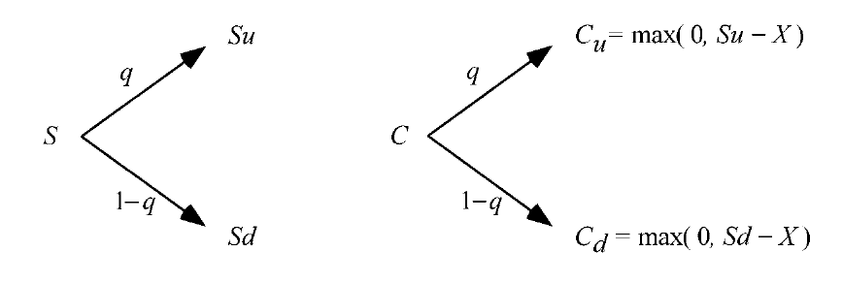
Option Basic

Slide 3
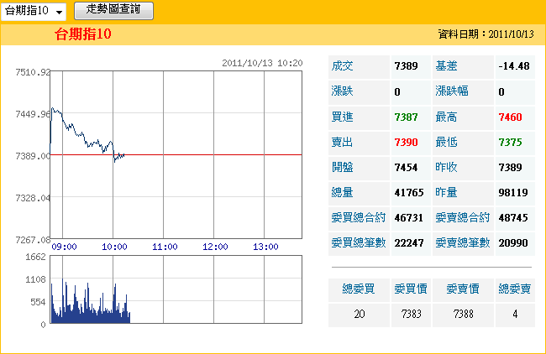
Arbitrage
因地、因時
Put-Call Parity：C – P + K = F
Call |  |  |  |  |  | Put
成交價 | 買價 | 賣價 | 漲跌 | 總量 | 履約價 | 成交價 | 買價 | 賣價 | 漲跌 | 總量
590 | 585 | 595 | ▽10 | 114 | 6800 | 4.3 | 4.3 | 4.6 | ▽3 | 2730
495 | 488 | 493 | ▽5 | 135 | 6900 | 6.6 | 6.6 | 6.7 | ▽3.9 | 3386
395 | 393 | 395 | ▽13 | 258 | 7000 | 11 | 11 | 11.5 | ▽5.5 | 5265
305 | 302 | 305 | ▽10 | 477 | 7100 | 18 | 18 | 18.5 | ▽9 | 10779
218 | 218 | 220 | ▽14 | 1352 | 7200 | 32.5 | 32.5 | 33 | ▽9.5 | 9775
144 | 143 | 144 | ▽13 | 2875 | 7300 | 57 | 57 | 58 | ▽10 | 11234
84 | 83 | 84 | ▽11 | 15680 | 7400 | 96 | 95 | 96 | ▽7 | 9872
40.5 | 40 | 40.5 | ▽9.5 | 18450 | 7500 | 155 | 155 | 156 | ▽6 | 5324
16 | 15.5 | 16 | ▽5.5 | 16638 | 7600 | 230 | 230 | 234 | ▽2 | 591

Slide 4

The Binomial Option Pricing Model
Replicate a call: h shares of stock + B dollars

Slide 5
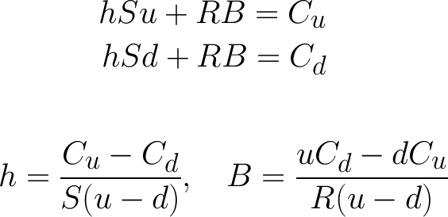
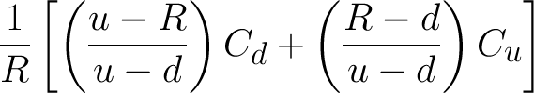
The Binomial Option Pricing Model
Value of h shares of stock + B dollars at t₀ :

Slide 6
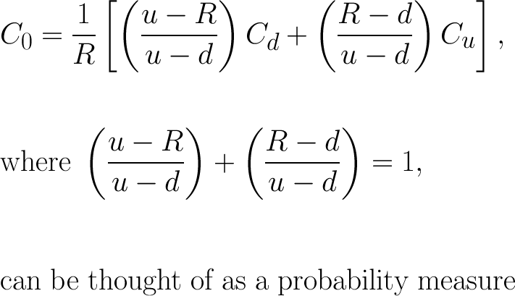
Risk Neutral Probability

Slide 7

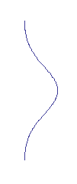
The Binomial Option Pricing Model
Due to the Central Limit Theorem, the risk neutral probability are normally distributed

Slide 8
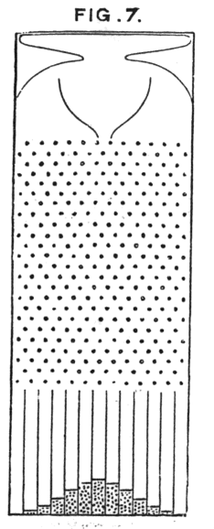

Slide 9
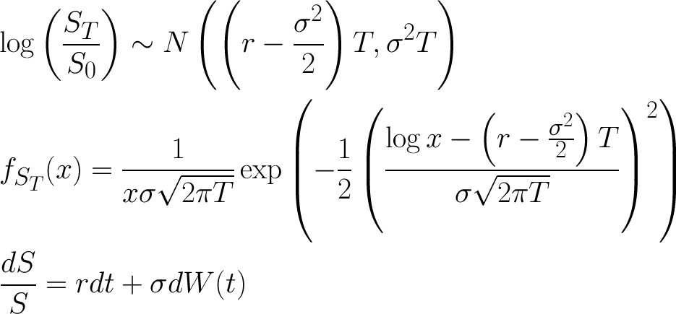

The Black-Scholes frame work

Slide 10
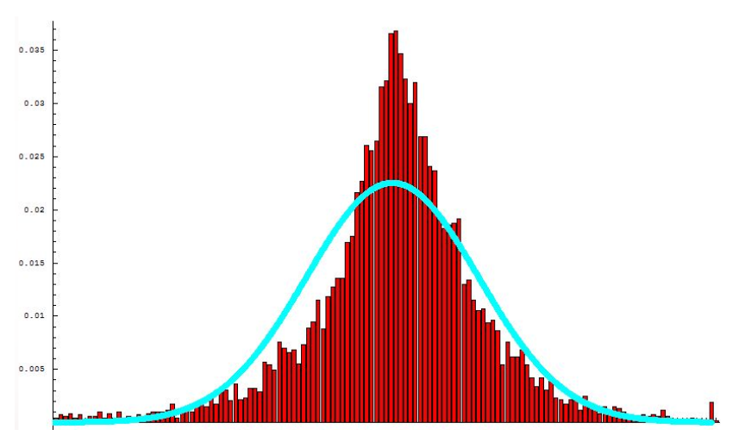
Empirical Distribution

Slide 11
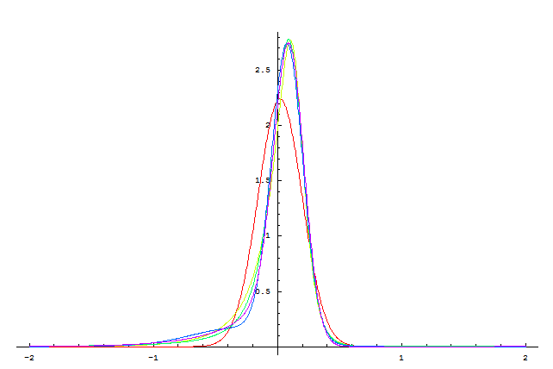
GBM
NIG
CGMY
DE
JD

Slide 12
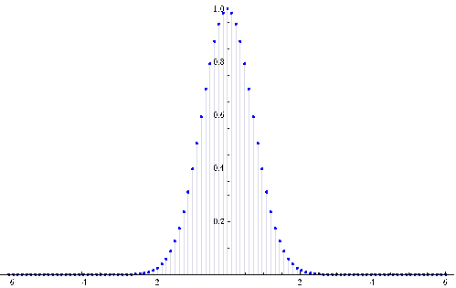
Numerical Method

Slide 13
Thanks for your attention!

